Slide 1
Department for Aging and Independent Living
Commissioner Victoria Elridge, MS, OTL
Branch Manager Carrie Anglin
April 21, 2022

Slide 2
CHFS Mission
To be a diverse and inclusive organization
providing programs, services, and supports
that protect and promote
the health and well-being
of all Kentuckians and their communities

Slide 3
CHFS Pillars
Full Human Potential
Equity
Health & Well-Being
Structural Economic Support
Resilient Individuals & Communities
Operational
Excellence

Slide 4
DAIL Quality Living Branch
Marnie Mountjoy, Division Director
Carrie Anglin, Branch Manager
Terri Pushell, Social Service Specialist
Jane Redmon, Social Service Specialist

Slide 5
Assisted Living Communities
115 Assisted Living Communities
1 Pending in Jefferson County
2 That are being built in Western KY

Slide 6
Assisted Living Units
4,840 Assisted Living Units
583 Memory Care Units
5,423 Total Units

Slide 8
Top 10 SONC Citations
Registry Checks Missing
FNAs Not Completed in Timeframe
POA Not on File
Incomplete Criminal Records Check
Orientation & Annual Trainings Not Completed in Timeframe
POCs not implemented
Personal Preferences and Social Factors not Completed in Timeframe
Fee Structure for Units
Missing or Incomplete Grievance Policy
Temporary Condition Not In Place

Slide 9
Background Checks
910 KAR 1:240 Section 7 states:
A criminal record check that shall:
a. Be requested in accordance with KRS 216.789(3);
b. Be applied for no sooner than forty-five (45) days prior to but no later than seven (7) days following an employee's first day of work;
c. Be checked every other year through the Kentucky Justice and Public
Safety Cabinet or Administrative Office of the Courts;
d. Include a criminal record check upon hire from any state in which the employee lived outside of Kentucky in the last three (3) years; and
e. Include a criminal record check at least every other year from the state in which the employee resides if the employee maintains residency outside of Kentucky; and
3. A check of the central registry, the adult protective services caregiver misconduct registry, and nurse aide registry that shall:
a. Be performed on an employee upon the initial date of hire and at least annually thereafter; and
b. Show that the employee was not found on the registries.
An assisted living community may use Kentucky's national background check program established by 906 KAR 1:190 to satisfy the background check requirements of this subsection.

Slide 10
KARES
Many ALC providers are using KARES to meet the requirement but the ALC team has found that providers are not completing the two step process to have a full check of the employee.
The providers take the FINAL REGISTRY RESULTS FORM page that is provided from KARES saying a registry check was completed but ALC are then not having staff get fingerprinted as the next step for EMPLOYMENT AUTHORIZATION FORM.

Slide 11
Incomplete background checks

Slide 12
Valid Results

Slide 16
CDC COVID-19 Community Levels
COVID-19 by County

Slide 17
Jefferson County COVID Level

Slide 18
What Residents and Visitors Can Do
Stay Up to Date with COVID-19 Vaccines
Wash Hands Often
Clean High Touch Surfaces
Wear A Mask With High Community Levels of COVID-19
Ensure Regular Care and Medical Services Continue

Slide 19
What ALCs Can Do
Stay Up to Date with COVID-19 Vaccines
Wash Hands Often
Clean High Touch Surfaces
Wear A Mask With High Community Levels of COVID-19
Develop and Implement COVID Mitigation Policies from

Slide 20
SB 11 Memo

Slide 21
Senate Bill 11 Transition
Fee Transition Plan
ALCs shall continue normal operaitons until formal transition letter is received (910 KAR 1:240)
ALCs will not pay duplicative certification/licensure fees with transition
All ALCs will transition from DAIL to OIG once regulation is enacted

Slide 22
Fee Transition Plan Example
Marnie’s Assisted Living Community pays DAIL the $100 that is currently required in regulation but when the program is transitioned to OIG the cost listed in regulation is $110, Marnie will need to pay OIG $10.

Slide 23
We Are Here For You
Victoria Elridge, Commissioner
Victoria.Elridge@ky.gov
Marnie Mountjoy, Division Director
Marnie.Mountjoy@ky.gov
Carrie Anglin, Branch Manager
Carrie.Anglin@ky.gov
Teri Pushell, Social Service Specialist
TeriA.Pushell@ky.gov
Jane Redmon, Social Service Specialist
Jane.Redmon@ky.gov

Slide 24
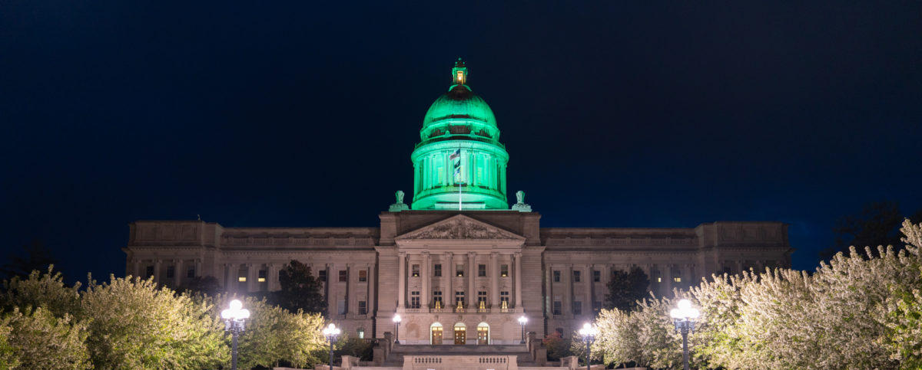
Thank You
For ALL You Do!

